Slide 1
OOP JavaScript
Autumn Frontend Internship 2021

Slide 2
Hi, I’m Paula

Slide 3
Agenda
OOP Concepts
Objects in JavaScript
Prototype and classes
TypeScript
Challenge

Slide 4
Let’s play a game!
Kahoot.it

Slide 5
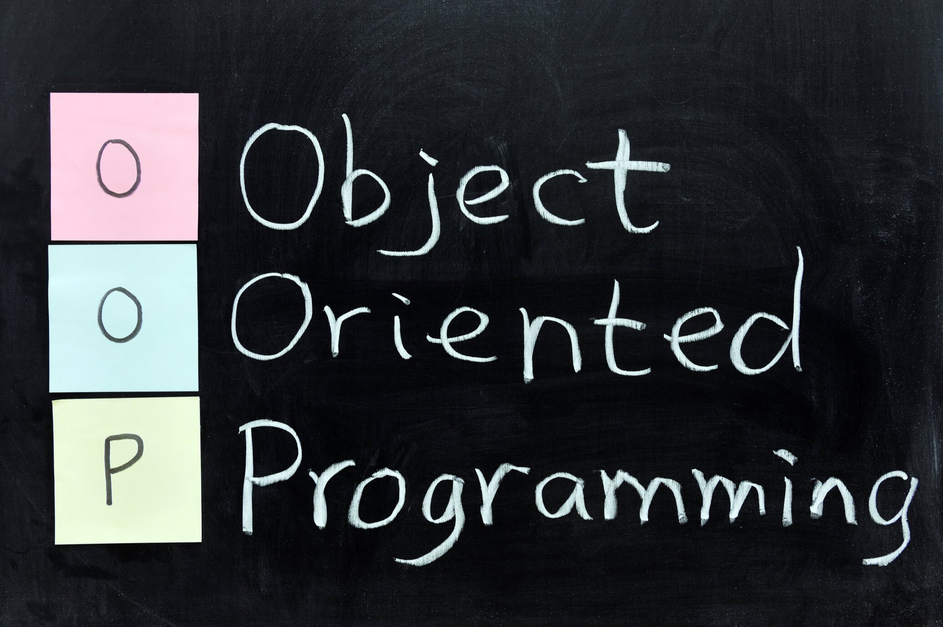

Slide 6
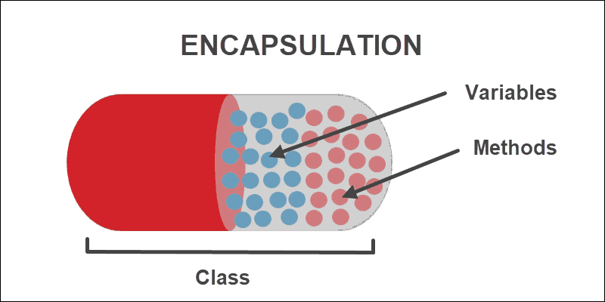
Encapsulation

Slide 7
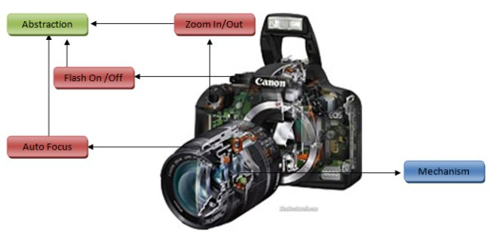
Abstraction

Slide 8
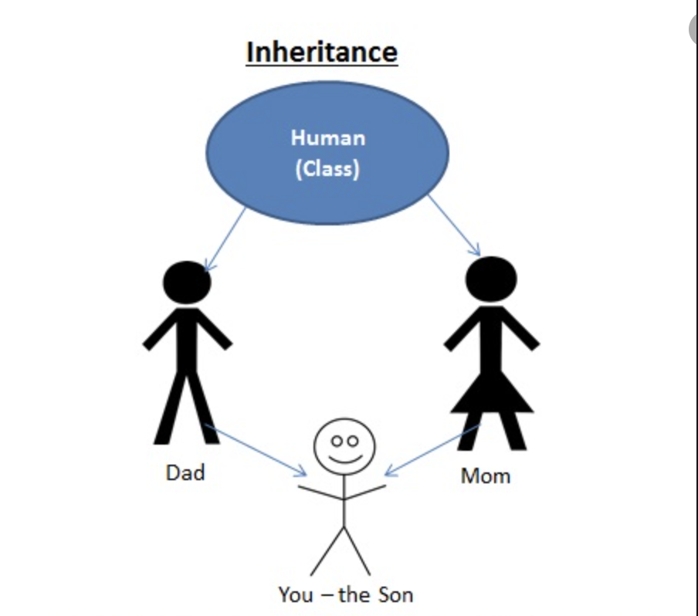
Inheritance

Slide 9
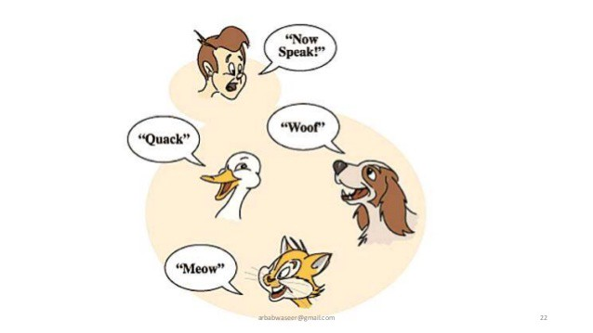
Polymorphism

Slide 10
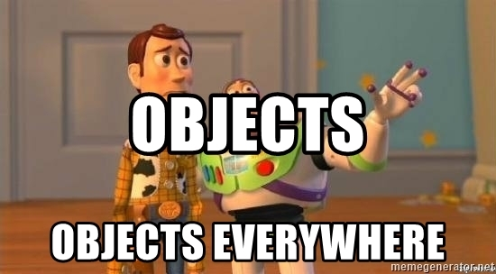
OOP in JavaScript

Slide 11
Objects in JavaScript
Objects are collections of properties and methods which represent data and functionality

Slide 12
Properties and methods
Name/value pair
Dynamic notation: property name as variable
Static notation:
Dot
Bracket

Slide 13
Constructors and instances
3 + 1

Slide 14
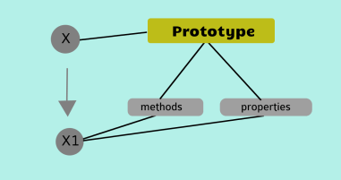
Prototype

Slide 15
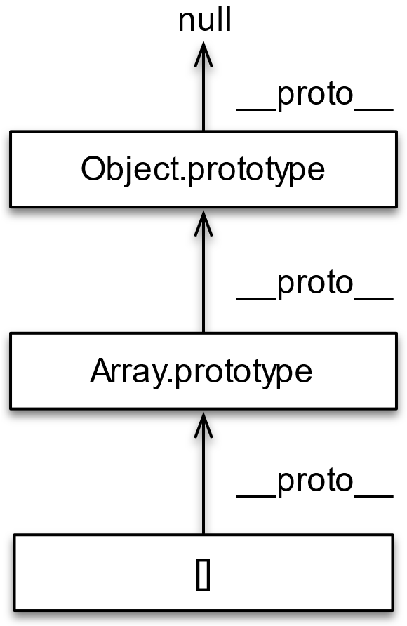
Prototype Chaining

Slide 16
Prototype chaining
Prototype vs __proto__
getPrototypeOf
Instance of
isPrototypeOf

Slide 17
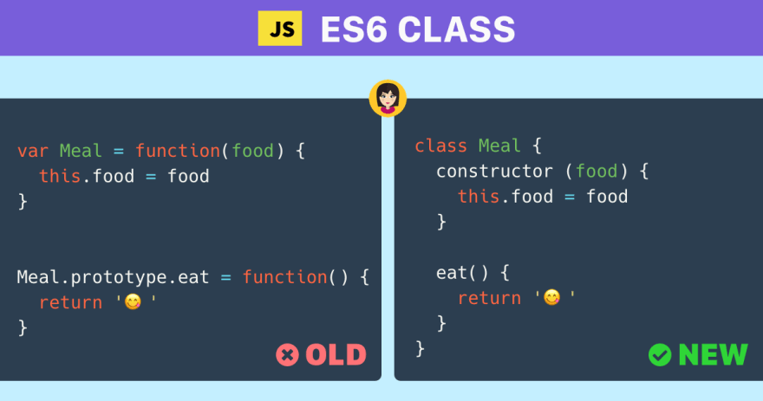
Class

Slide 18
Class
Extends
Super
This

Slide 19


Slide 20

What?

Slide 21
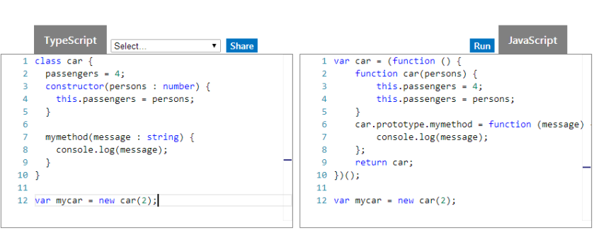

Slide 22

https://github.com/microsoft/TypeScript

Slide 23
How to install?
npm install –g typescript
run tsc file.ts / add compilation task to build script

Slide 24
Advantages
OOP
Easy to debug
Better structuring: modules, classes, interfaces
Proper documentation
Compile time checks
Automatic type inference

Slide 25
Disadvantages
Extra step: transpilation
New syntax

Slide 26
Features
Type Annotations
“any” type
Compile Time Checking
Classes
Inheritance
Interfaces
Modules
Enums
GenericsTuples
….

Slide 27
Type Annotations
let myName: string = "Alice";
// No type annotation needed -- 'herName' inferred as type 'string'
let herName = "Alice";
// Parameter type annotation
function greet(name: string) {
console.log("Hello, " + name.toUpperCase() + "!!");
}
// Return type annotation
function getFavoriteNumber(): number {
return 26;
}

Slide 28
//Optional properties
function printName(obj: { first: string; last?: string }) {
// ...
}
printName({ first: "Bob" });
printName({ first: "Alice", last: "Alisson" });
//Union types
function printId(id: number | string) {
console.log("Your ID is: " + id);
}
// OK
printId(101);
// OK
printId("202");
// Error
printId({ myID: 22342 });

Slide 29
Classes
class Student {
fullName: string;
constructor(
public firstName: string,
public middleInitial: string,
public lastName: string
) {
this.fullName = firstName + " " + middleInitial + " " + lastName;
}
}
interface Person {
firstName: string;
lastName: string;
}
function greeter(person: Person) {
return "Hello, " + person.firstName + " " + person.lastName;
}
let user = new Student("Jane", "M.", "User");

Slide 30
Extending classes
class Animal {
move(distanceInMeters: number = 0) {
console.log(`Animal moved ${distanceInMeters}m.`);
}
}
class Dog extends Animal {
bark() {
console.log("Woof! Woof!");
}
}
const dog = new Dog();
dog.bark();
dog.move(10);
dog.bark();

Slide 31
Public, Private, Protected
class BigAnimal {
private name: string;
public type: string;
protected age: number;
constructor(theName: string, type: string, age: number) {
this.name = theName;
this.type = type;
this.age = age;
}
}
class Rhino extends BigAnimal {
constructor() {
super("Rhino", "big", 20);
}
}
let animal = new BigAnimal("Goat", "medium", 17);
let rhino = new Rhino();
animal.name
animal.type
animal.age
rhino.name
rhino.type
rhino.age

Slide 32
Static, readonly
class Grid {
static origin = { x: 0, y: 0 };
calculateDistanceFromOrigin(point: { x: number; y: number }) {
let xDist = point.x - Grid.origin.x;
let yDist = point.y - Grid.origin.y;
return Math.sqrt(xDist * xDist + yDist * yDist) / this.scale;
}
constructor(public scale: number) {}
}
let grid1 = new Grid(1.0); // 1x scale
let grid2 = new Grid(5.0); // 5x scale
class Octopus {
readonly name: string;
readonly numberOfLegs: number = 8;
constructor(theName: string) {
this.name = theName;
}
}
let dad = new Octopus("Man with the 8 strong legs");
dad.name = "Man with the 3-piece suit";

Slide 33
Abstract classes
abstract class Animal {
abstract makeSound(): void;
move(): void {
console.log("roaming the earth...");
}
}

Slide 34
Type Aliases
type Point = {
x: number;
y: number;
};
function printCoord(pt: Point) {
console.log("The coordinate's x value is " + pt.x);
console.log("The coordinate's y value is " + pt.y);
}
printCoord({ x: 100, y: 100 });

Slide 35
Interfaces
interface Point {
x: number;
y: number;
}
function printCoord(pt: Point) {
console.log("The coordinate's x value is " + pt.x);
console.log("The coordinate's y value is " + pt.y);
}
printCoord({ x: 100, y: 100 });

Slide 36
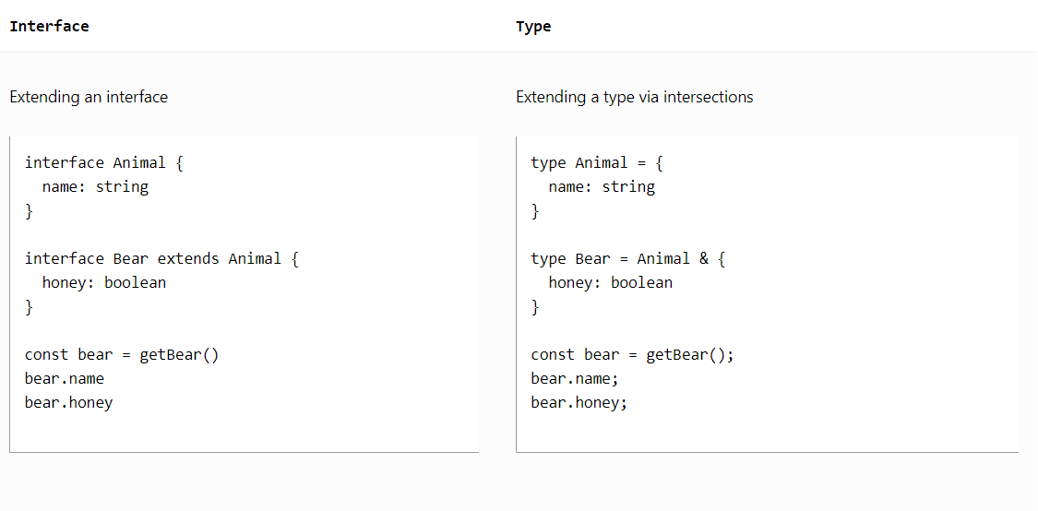

Slide 37
Function Types
interface SearchFunc {
(source: string, subString: string): boolean;
}
let mySearch: SearchFunc;
mySearch = function (source: string, subString: string): boolean {
let result = source.search(subString);
return result > -1;
};

Slide 38
Extending interfaces
interface Shape {
color: string;
}
interface Square extends Shape {
sideLength: number;
}
let square = {} as Square;
square.color = "blue";
square.sideLength = 10;

Slide 39
Extending classes
class Control {
private state: any;
}
interface SelectableControl extends Control {
select(): void;
}
class Button extends Control implements SelectableControl {
select() {}
}

Slide 40
Enums
//Numeric enums
enum Direction {
Up = 1,
Down,
Left,
Right,
}
// all automatically incremented
//String enums
enum Color {
Red = "RED",
Blue = "BLUE",
Green = "GREEN"
}

Slide 41

https://www.typescriptlang.org/play

